Slide 1
Large Language Models
and Knowledge Graphs
KC Graph Databases Meetup
June 20, 2023

Slide 2
What are Large Language Models
Machine learning models that have been trained on large volumes of text
Incorporate billions of parameters
Generate fluent, conversational text by predicting the most likely words to appear in response to a prompt.

Slide 3
Applications of large language models (according to ChatGPT)
Natural language understanding
Named entity recognition
Sentiment analysis
Text classification
Language generation
Chat bots
Text completion
Machine translation
Text summarization
Content recommendation

Slide 4
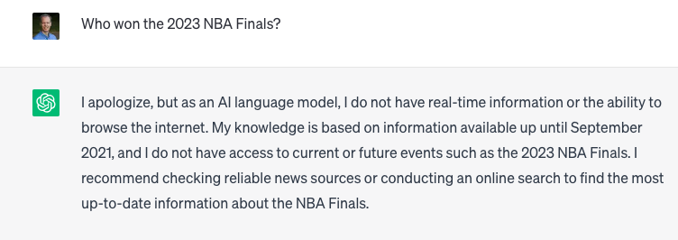
Limitations of large language models
They only have access to data they were trained on

Slide 5
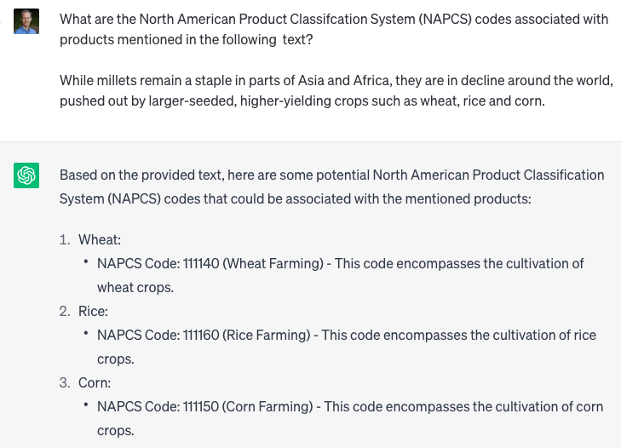
Hallucinations

Slide 6
Solutions
Retraining the LLM
Impractical, expensive
Fine-tuning the LLM
Provide additional examples of prompts and responses
Grounding the LLM
Provide the model with context to answer correctly for a specific domain

Slide 7
Retrieval Augmented Generation
Use a LLM to turn a natural language question into a query
Retrieve information from a data store
Use the LLM to format the query results into a conversational format

Slide 8
Vector-based RAG
Break text into chunks (phrases, sentences, paragraphs, documents)
Create vector representations of each text chunk
Create a vector representation of the natural language query
Return the k nearest vectors to the query
Use LLM to generate a conversational response to the natural language query based on the vector query results

Slide 9
Knowledge-graph based RAG
Represent domain as a knowledge graph
Use LLM to turn natural language queries into graph query language
Retrieve the results of the graph query
Use LLM to generate a conversational response to the natural language query based on the vector query results

Slide 10
Strengths of vector-based RAG
Strength | Vector-based | Graph-based
Ease of generating correct query | Any sentence can be turned into a vector | LLM is not guaranteed to generate accurate graph query syntax
Ease of generating knowledge base | Any text can be vectorized. No easy answer for how much text to include in each chunk. | Designing the knowledge graph schema and extracting entities and relationships from unstructured text can be time consuming
Fuzzy matching query to knowledge base | Any query vector will have k nearest neighbors. Optimal top k and similarity threshold might differ from one query to the next | Query must anchor on specific nodes in the knowledge graph.

Slide 11
Strengths of graph-based RAG
Strength | Vector-based | Graph-based
Representing facts | Represents similarity, not logical relationships between statements | Captures factual assertions. Can use relationship weights to represent confidence.
Flexibility of data model | Requires text as the data source. Queries are based on top k or similarity threshold. | Properties can be different types. Nodes can have any number of relationships
Interpreting and correcting data model | Vectors are not human readable. Vectors can't be easily moved to correct misrepresentations. | Graph model is human readable. Relationships can be modified to correct the model
Representing context | Text chunks are vectorized in isolation | Graph queries can easily traverse multiple relationships, relate hierarchical subsections to main topics

Slide 12
Hybrid approach
Store text embedding vectors as node properties in a graph database
Create a vector representation of the natural language query
Find the k-nearest nodes to the query based on vector similarity
Traverse the graph to find related nodes
“Which authors have published papers about k-core decomposition?”
Use semantic search to find topic nodes
Traverse from topic nodes to articles and authors

Slide 13
Demo
Graph-based RAG for Women’s World Cup

Slide 14
Generating knowledge graphs
Turning unstructured text into knowledge graphs unlocks value, but is time consuming
Off-the-shelf named entity recognition models might not be relevant to your domain
LLM’s are good at learning based on a few examples
Can accelerate human annotation of training data

Slide 15







Legislation and classification hierarchies are loaded in Neo4j
Large Language Model suggests entities in legislation
Human experts correct suggested entities to produce a golden dataset
Use the golden dataset to train and evaluate a Named Entity Recognition (NER) model
industry occupation chemical
industry occupation chemical
raw coal means coal that does not require processing in a coal preparation plant before it is transported from the mine site for marketing or testing;
raw coal means coal that does not require processing in a coal preparation plant before it is transported from the mine site for marketing or testing;

Slide 16

Apply NER model to all legislation. Create entities related to legislation text in Neo4j. Entities have a text embedding property.
Neo4j GDS finds the classification examples with the most similar text embeddings to the extracted entities.
raw coal
[.021, .381, …]
NAPCS 1441111: anthracite
raw coal means coal that does not require processing in a coal preparation plant before it is transported from the mine site for marketing or testing;
coal preparation plant
[.023, .490, …]
NAPCS 1441122: other bituminous coal
raw coal
mine
[.821, .502, …]
NAPCS 2611111: coal coke
NAPCS 5511891: coal at wholesale
NAPCS 641211: mineral exploration

Slide 17
Human annotator identifies the best classification for a sample of entities to create a golden named entity linking dataset
Use the golden dataset to train and evaluate a Named Entity Linking (NEL) model
NAPCS 1441111: anthracite
NAPCS 1441122: other bituminous coal
raw coal means coal that does not require processing in a coal preparation plant before it is transported from the mine site for marketing or testing;
raw coal
NAPCS 2611111: coal coke
NAPCS 5511891: coal at wholesale
NAPCS 641211: mineral exploration

Slide 18
Run the entity linking model for all legislation, linking legislation to standards and classifications.
Store the results as a Neo4j knowledge graph.
NAPCS
Legislation
NAICS
NOC
Chemicals

Slide 19
Demo
Find custom entities in sports articles

